Slide 1
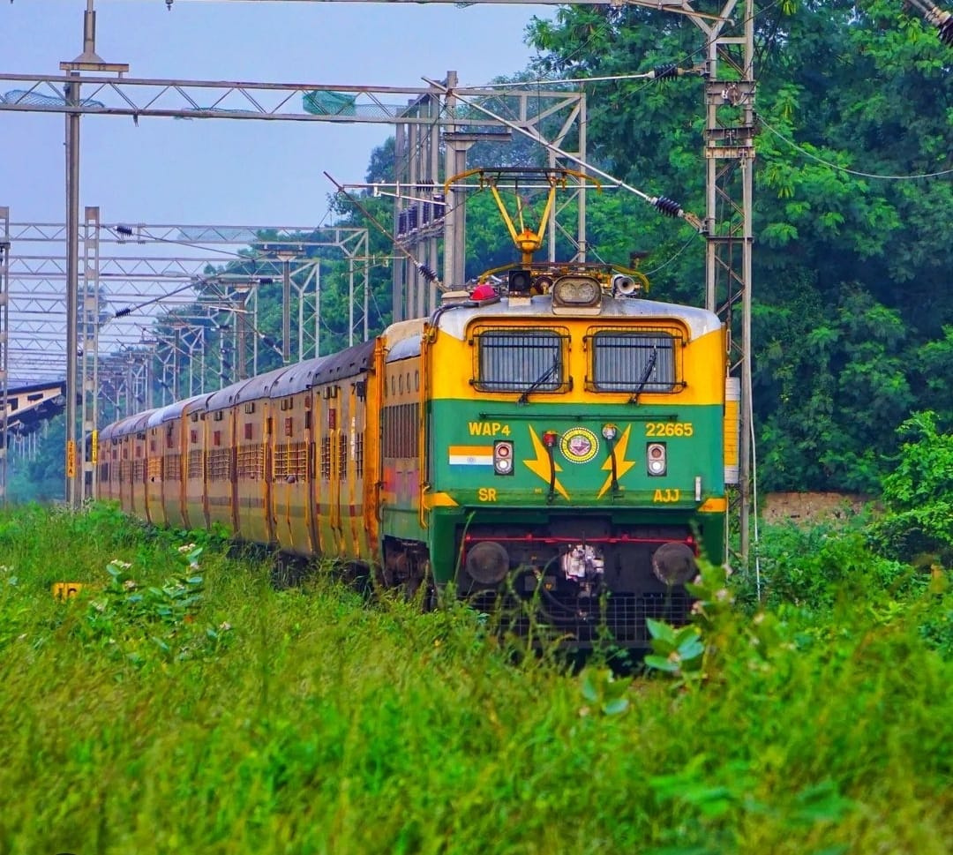
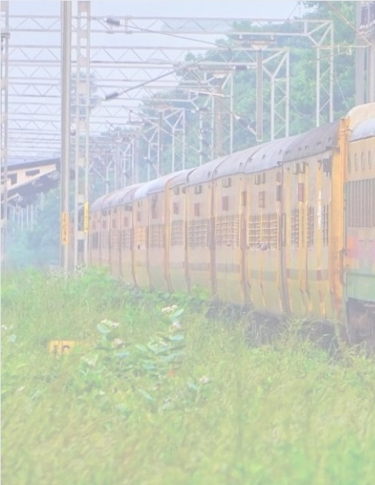
Railway Track
Crack Detection System
Team Members
Pushkala.S - 21011102075 - IoTB
G.S. Ruparani - 21011102032 - IoTA
Vishal. B - 21011102021 - IoTA

Slide 2
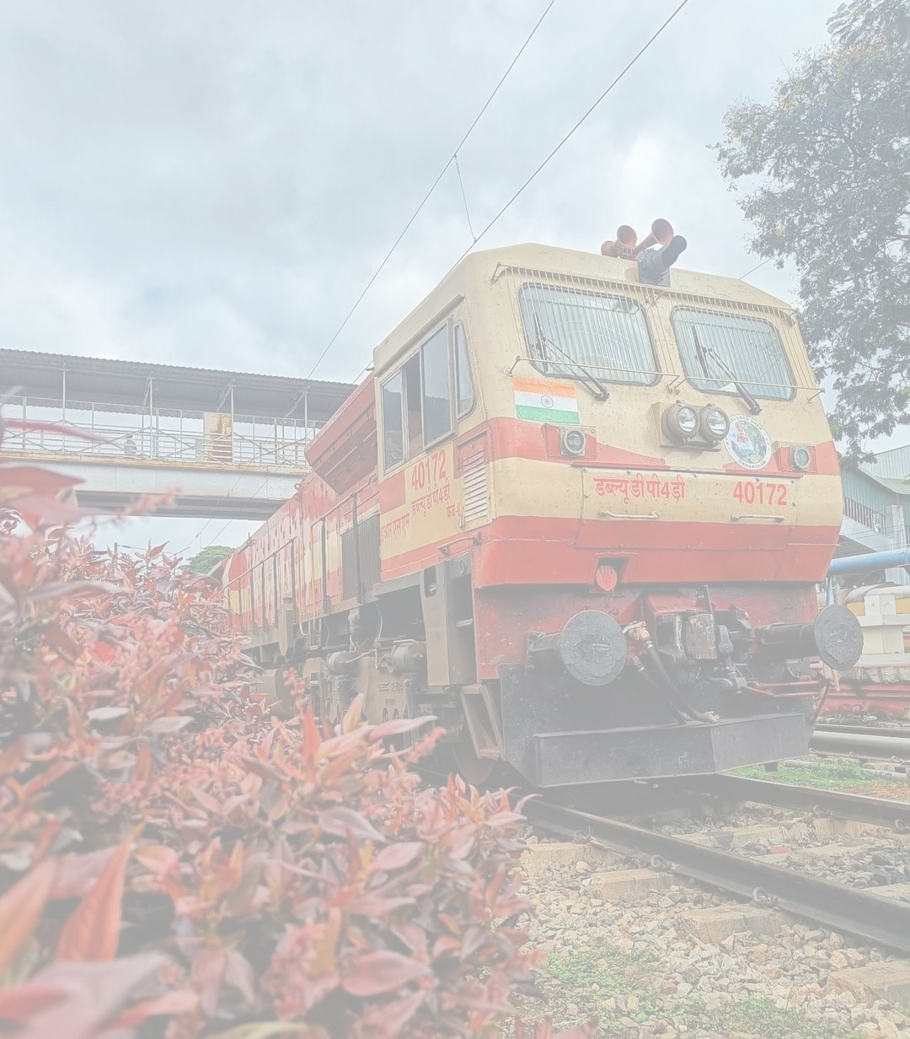
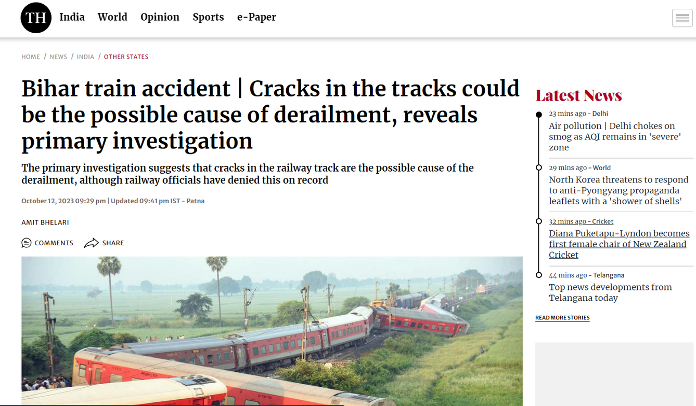
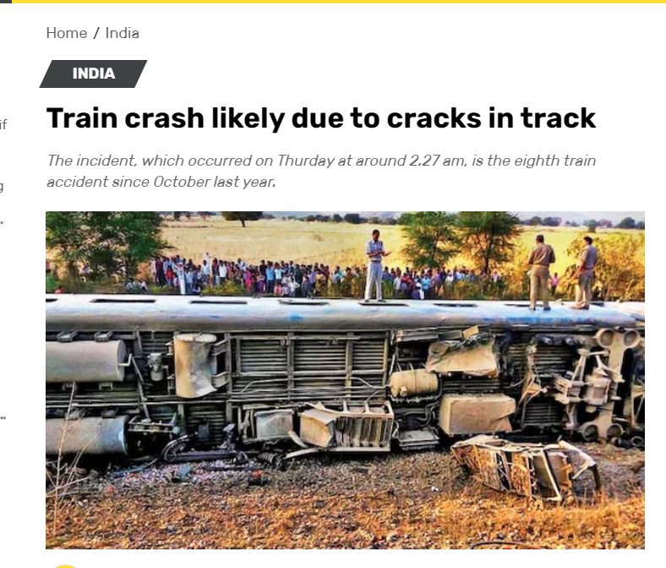

Slide 3
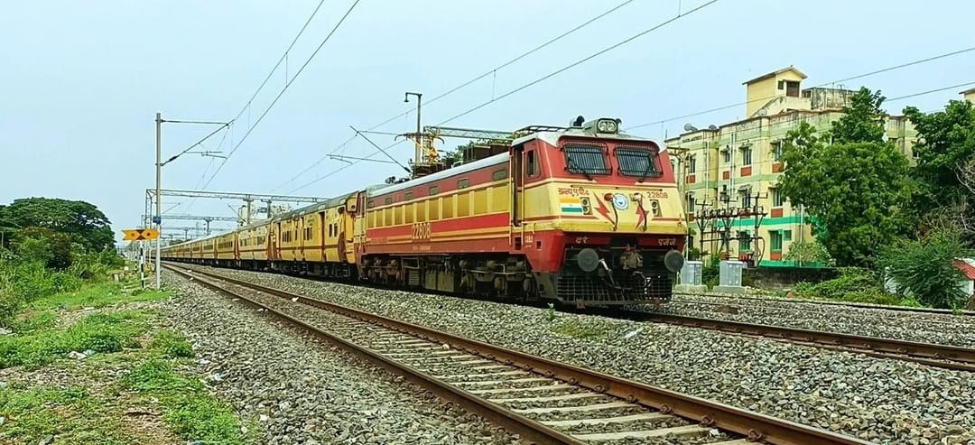
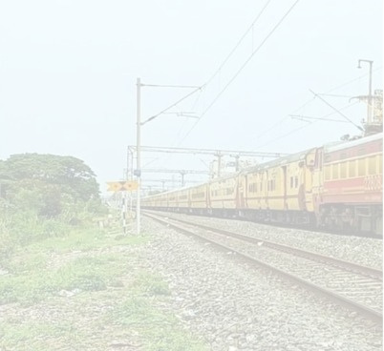
Problem statement
Railway accidents in India are predominantly caused
by railway track crossing and unidentified cracks in rail
tracks, resulting in the loss of lives and economic
damage. There is a critical need for a robust, efficient,
and stable technology for both crack detection in
railway tracks and object detection to enhance railway
safety. The project aims to develop a Railway Track
Crack Detection System using sensors, combining GPS
tracking and a GSM module to send alert messages
and geographical coordinates. An Arduino
Microcontroller is employed to coordinate the
system's activities.

Slide 4
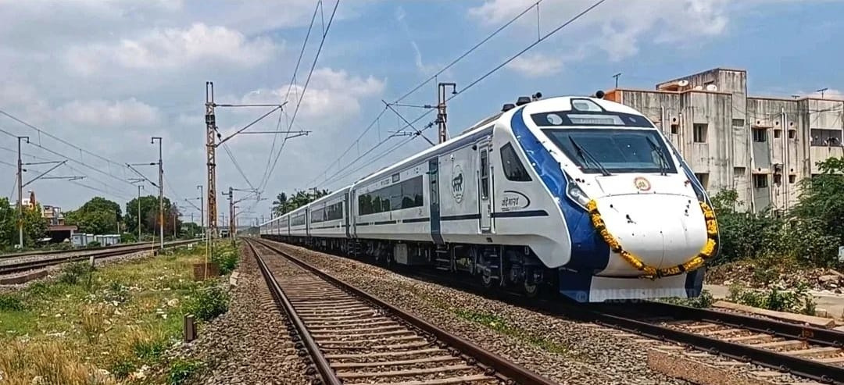
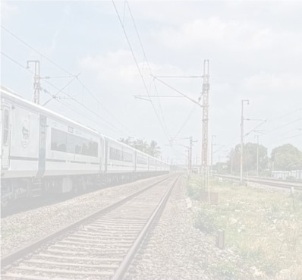
Solution / Innovation / Business Model
In proposed system crack in the tracks are detected by means of sensor and Arduino microcontroller, measuring distance for two railroad. In this project we use ultrasonic sensor to detect the crack. It uses to measure the distance between the two tracks. If any crack is occurred in the track means longitude and latitude coordinates of the place are to be sent to the nearest station or control room and ultrasonic sensor measured the distance between the two track if there is any small variance found the message which contains coordinates of that particular place will be sent to the nearest station or control room with the help of GPS and GSM module. This project is to be made in order to change the system of crack detection in railways which can be resulted out as not only cost-effective but also with good accuracy and time saving facility.

Slide 5
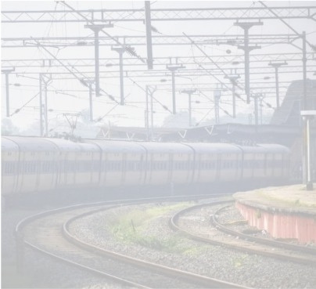
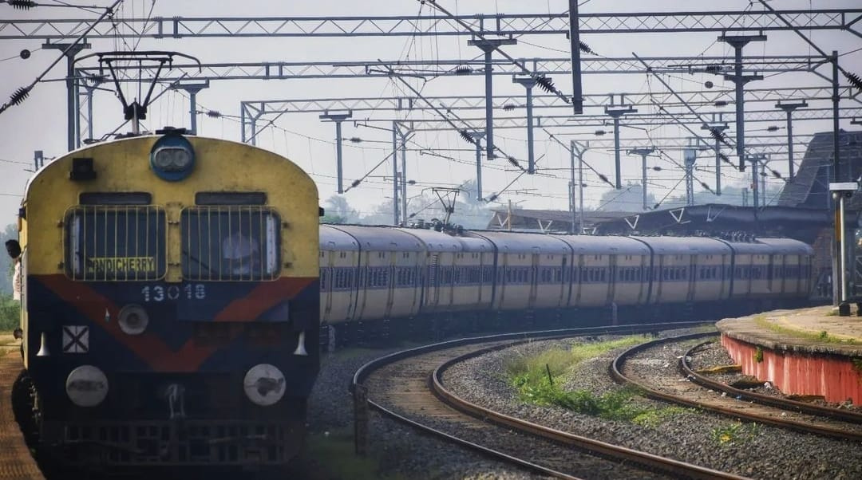
Employment- Direct/Indirect
Engineers and developers to design, build, and maintain the system.
Technicians for installation, testing, and calibration.
Railway personnel to oversee the system's operation and maintenance.
Data analysts for tracking and analyzing historical data.
Control room operators to monitor incoming alerts and coordinate response.
Benefit (Commodity/Service wise) in monetary terms
Accurate and real-time crack detection to prevent accidents.
Reduction in loss of life and economic damage.
Efficient and cost-effective system.
Job opportunities in system deployment and maintenance.
Improved railway safety and reliability.

Slide 6
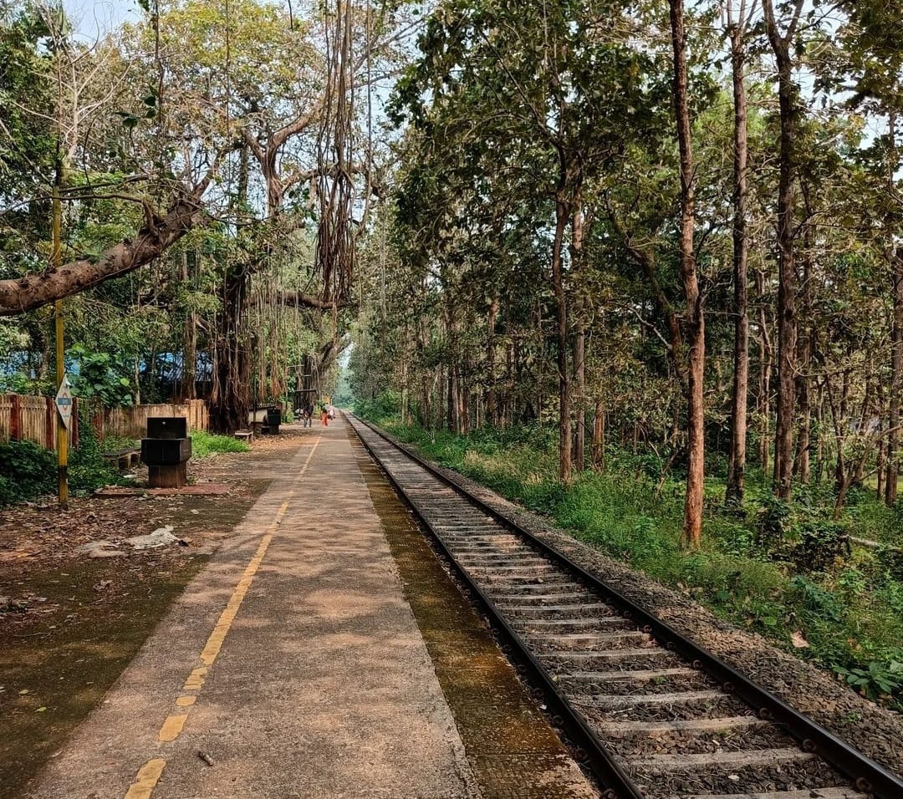
Hardware :
SIM800A GSM Module
L293D Motor Driver
Ultrasonic Sensor HCR-RO5
GU-BLOX NEO 6M GPS Module
Arduino UNO 3

Slide 7
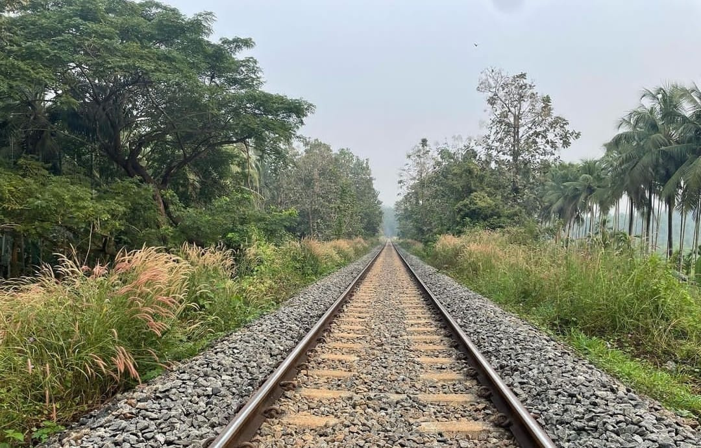
Software :
Arduino programming to control and coordinate the system's activities.
GSM module communication through AT commands to send alert messages.
GPS module to obtain precise location coordinates.
Ultrasonic sensor for crack detection.

Slide 8
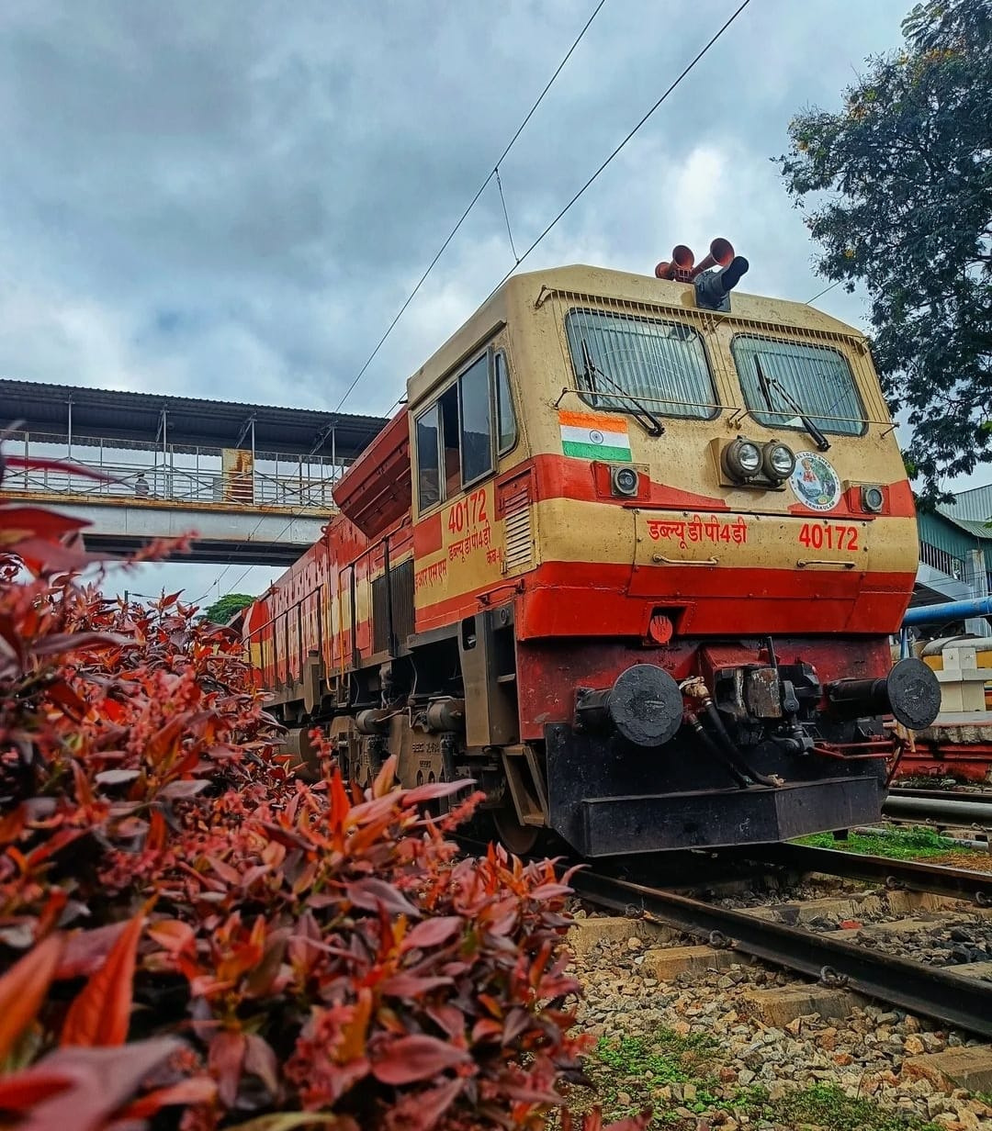
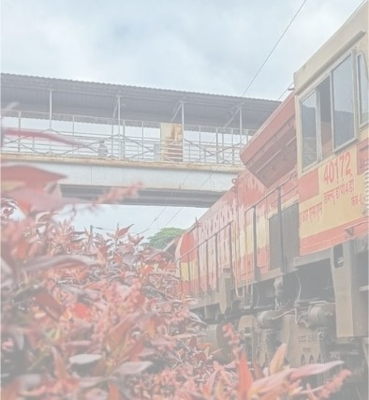
Future Plan :
Our Future plan with this project is that we can attach this prototype in the battery box of each Loco in Railways so that it can detects while the train is moving and pass the information about the crack to the nearest Substations which will reduce the accidents and also reduce the workload of gangmans.
And the main future plan is that we request the Southern Railways a trial section with a Loco to test the Project and implement in real life so that this will implemented to whole Indian Railways.

